Slide 1
Enhanced Volcano Plots

Slide 2
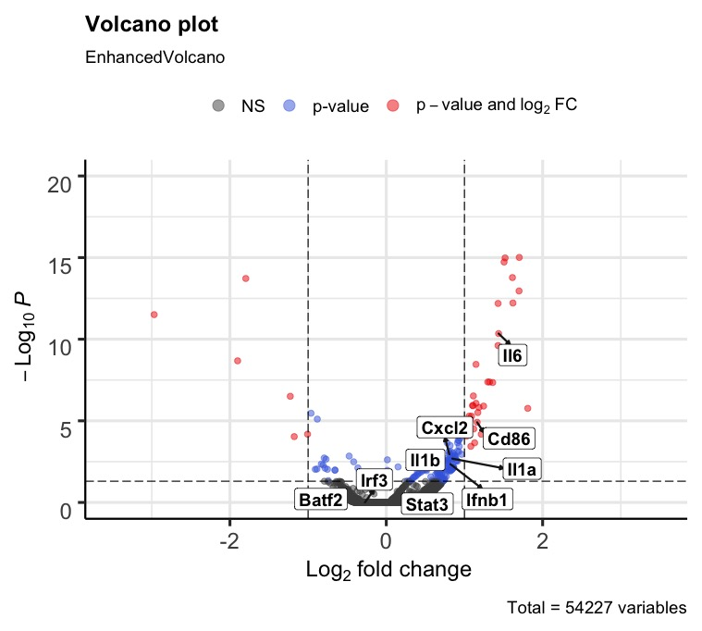
Y axis limit
0,20
X limit
-3.5,-3.5
Foldchange cut off
1
P adjusted value cut off
0.05

Slide 3
Source and examples
https://www.bioconductor.org/packages/release/bioc/vignettes/EnhancedVolcano/inst/doc/EnhancedVolcano.html#acknowledgments

